Slide 1
EE227 – Digital Logic Design
Lecture 16

Slide 2
Outline
4 to 16 line decoder
Combinational Logic Implementation with Decoders
Full Adder with Decoder
Encoder
Priority Encoder

Slide 3
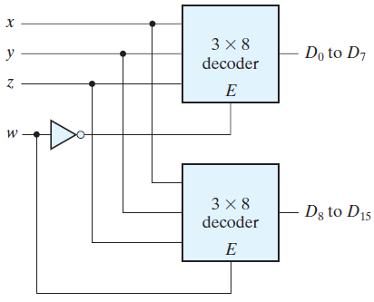
4 to 16 Line Decoder
Two 3-to-8-line decoders with enable inputs connected to form a 4-to-16-line decoder
When w = 0, the top decoder is enabled and the other is disabled
The bottom decoder outputs are all 0’s, and the top eight outputs generate minterms 0000 to 0111
When w = 1, the enable conditions are reversed, the bottom decoder outputs generate minterms 1000 to 1111, while the outputs of the top decoder are all 0’s

Slide 4
Combinational Logic Implementation with Decoders (1/2)
A decoder provides the 2^{n} minterms of n input variables
Each asserted output of the decoder is associated with a unique pattern of input bits
Since any Boolean function can be expressed in sum-of-minterms form, a decoder that generates the minterms of the function, together with an external OR gate that forms their logical sum, provides a hardware implementation of the function
In this way, any combinational circuit with n inputs and m outputs can be implemented with an n – to -2^{n} line decoder and m OR gates

Slide 5
Combinational Logic Implementation with Decoders (2/2)
The procedure for implementing a combinational circuit by means of a decoder and OR gates requires that the Boolean function for the circuit be expressed as a sum of minterms
A decoder is then chosen that generates all the minterms of the input variables
The inputs to each OR gate are selected from the decoder outputs according to the list of minterms of each function

Slide 6
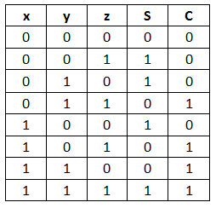
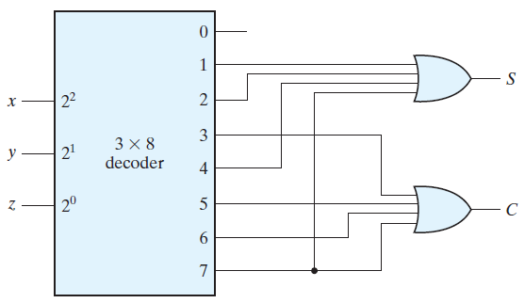
Full Adder with Decoder
S = Σ(1, 2, 4, 7)
C = Σ(3, 5, 6, 7)

Slide 7
Functions with Large Inputs
A function with a long list of minterms requires an OR gate with a large number of inputs
A function having a list of k minterms can be expressed in its complemented form F’ with 2^{n} – k minterms
If the number of minterms in the function is greater than 2^{n}/2, then F’ can be expressed with fewer minterms
In such a case, it is advantageous to use a NOR gate to sum the minterms of F’
The output of the NOR gate complements this sum and generates the normal output F

Slide 8
Implementation of Functions with Decoders with NAND Gates
If NAND gates are used for the decoder, then the external gates must be NAND gates instead of OR gates
This is because a two-level NAND gate circuit implements a sum-of-minterms function and is equivalent to a two-level AND – OR circuit

Slide 9
Encoder
An encoder is a digital circuit that performs the inverse operation of a decoder
An encoder has 2^{n} (or fewer) input lines and n output lines
The output lines, as an aggregate, generate the binary code corresponding to the input value

Slide 10
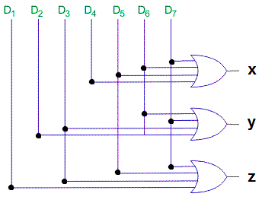
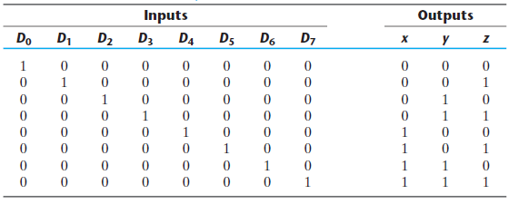
Octal to Binary Encoder
z = D₁ + D₃ + D₅ + D₇
y = D₂ + D₃ + D₆ + D₇
x = D₄ + D₅ + D₆ + D₇

Slide 11
Limitations of a Simple Encoder
The encoder defined in last slide has the limitation that only one input can be active at any given time
If two inputs are active simultaneously, the output produces an undefined combination
For example, if D₃ and D₆ are 1 simultaneously, the output of the encoder will be 111 because all three outputs are equal to 1
The output 111 does not represent either binary 3 or binary 6
To resolve this ambiguity, encoder circuits must establish an input priority to ensure that only one input is encoded

Slide 12
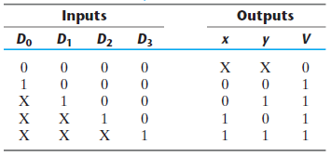
Priority Encoder (1/4)
A priority encoder is an encoder circuit that includes the priority function
The operation of the priority encoder is such that if two or more inputs are equal to 1 at the same time, the input having the highest priority will take precedence
Truth table of a 4 bit priority encoder is shown below
V is a valid bit indicator
That is set to 1 when one or more inputs are equal to 1
If all inputs are 0, there is no valid input and V is equal to 0
D₃ has the highest priority and D₀ has the lowest priority
The priority is defined in this sequence D₃, D₂, D₁, D₀

Slide 13
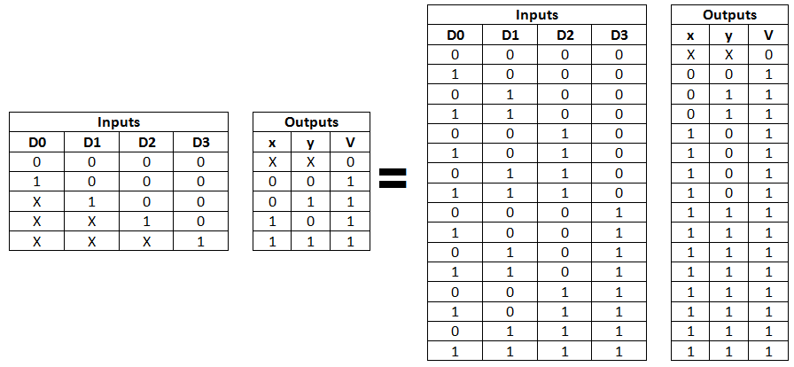
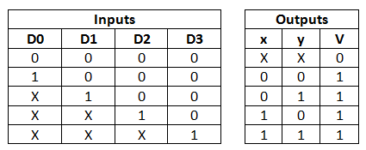
Priority Encoder (2/4)

Slide 14
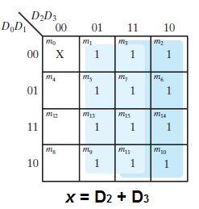
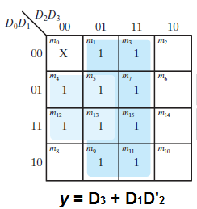
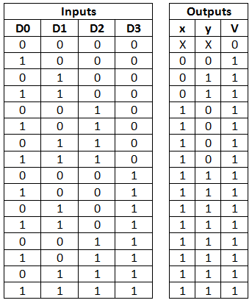
Priority Encoder (3/4)
x = D₂ + D₃
y = D₃ + D₁D’₂
V = D₀ + D₁ + D₂ + D₃

Slide 15
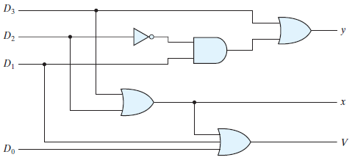
Priority Encoder (4/4)
x = D₂ + D₃
y = D₃ + D₁D’₂
V = D₀ + D₁ + D₂ + D₃

Slide 16
Multiplexer
A multiplexer is a combinational circuit that selects binary information from one of many input lines and directs it to a single output line
The selection of a particular input line is controlled by a set of selection lines
Normally, there are 2^{n} input lines and n selection lines whose bit combinations determine which input is selected

Slide 17
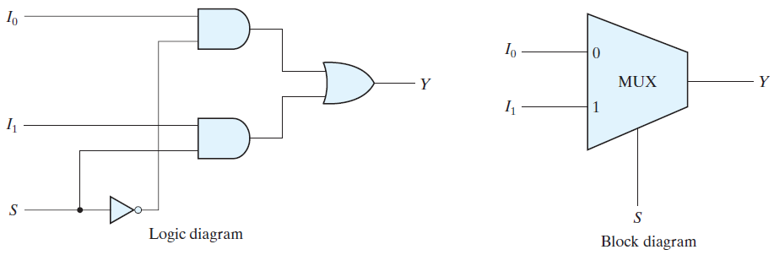
2 to 1 Line Multiplexer
A two-to-one-line multiplexer connects one of two 1-bit sources to a common destination
The circuit has two data input lines, one output line, and one selection line S
When S = 0, the upper AND gate is enabled and I₀ has a path to the output
When S = 1, the lower AND gate is enabled and I₁ has a path to the output

